Slide 1
CSE 2215: Data Structure and Algorithms-I
Introduction

Slide 2
Lecturer Introduction
Special gratitude for the course slides and materials:
Shadman Aadeeb
Lecturer, Dept. of CSE, UIU
Course Lecturer:
Asif Abrar (BSc in CSE, IUT)
Lecturer, Dept. of CSE, UIU
Email: asifabrar@cse.uiu.ac.bd
Room: 933D
Contact: 01552375341(Use only in case of emergencies)

Slide 3
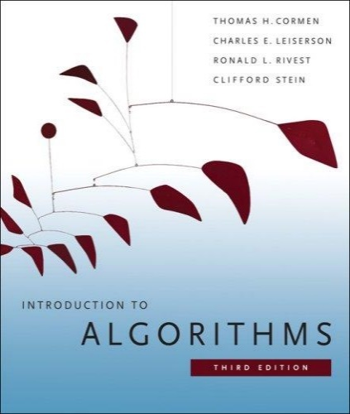
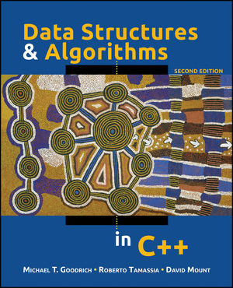
The Course
Text Books
Introduction to Algorithms (Third edition)
Cormen, Leiserson, Rivest, and Stein
An excellent reference you should own
Data Structures and Algorithms in C++
Goodrich, Tamassia, and Mount

Slide 4
General Guidelines
Don’t be afraid
Ask questions
Consultation hours are walk-in but pre-appointments are appreciated
Be PRESENT in class :) and be on TIME
For valid excuses, send me an email with the documents and proofs :)
Lastly, NO ONE KNOWS EVERYTHING, TEACH ME TO TEACH YOU BETTER!

Slide 5
Let’s get Introduced
Your name
Your school & college
Your passion/hobbies
What made you choose UIU?
Your expectations

Slide 6
Little Bit of Highlight
Let’s look at our contents for the semester now!
4 quizzes will be taken throughout the trimester
2 before mid and 2 after mid (NO QUIZ IN THE LAST WEEK)
20 marks per quiz (Syllabus- only 1 topic or 2 slides max)
One Instruction:
DO NOT CHEAT! :)
write what you can and I’ll be as just as possible

Slide 7
Contents
Introduction to Data Structures
Introduction to Algorithms
Analysis of Algorithms
Course Outline: Click me!
Section-wise Progress: Click me!

Slide 8
INTRODUCTION TO DATA STRUCTURES

Slide 9
What is a Data Structure?
Data is a collection of facts, such as values, numbers, words, measurements, or observations.
Structure means a set of rules that holds the data together.
A data structure is a particular way of storing and organizing data in a computer so that it can be used efficiently.
Different kinds of data structures are suited to different kinds of applications, and some are highly specialized to specific tasks.
Data structures provide a means to manage huge amount of data efficiently.

Slide 10
Types of Data Structures
Data structures are classified as either
Linear (e.g, arrays, linked lists), or
Nonlinear (e.g, trees, graphs, etc.)
A data structure is said to be linear if it satisfies the following four conditions
There is a unique element called the first
There is a unique element called the last
Every element, except the last, has a unique successor
Every element, except the first, has a unique predecessor
There are two ways of representing a linear data structure in memory
By means of sequential memory locations (arrays)
By means of pointers or links (linked lists)

Slide 11
INTRODUCTION TO ALGORITHMS

Slide 12
What is an Algorithm?
An algorithm is a sequence of computational steps that transform the input into the output.
An algorithm is a tool for solving a well-specified computational problem.
An algorithm is said to be correct if, for every input instance, it halts with the correct output
An incorrect algorithm might not halt at all on some input instances, or it might halt with other than the desired output.
Note that algorithms existed way before the invention of computers

Slide 13

What is a Program?
A program is the expression of an algorithm in a programming language
A set of instructions which the computer will follow to solve a problem

Slide 14
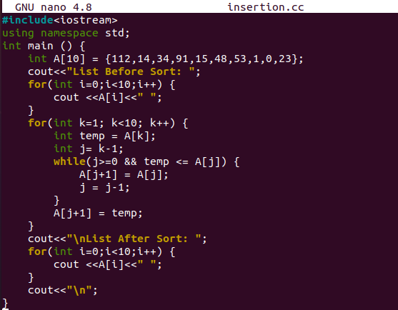
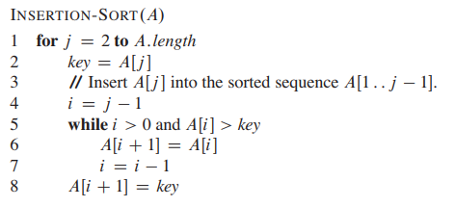
Algorithm vs Program

Slide 15
The Big Picture
Problem:
Input is a sequence of integers stored in an array.
Output the minimum.
INPUT
Algorithm
OUTPUT
m:= a[1];
for I:=2 to size of input
if m > a[i] then
m:=a[I];
return s
a[]:
25, 90, 53, 23, 11, 34
11
m, a[i]
Data-Structure

Slide 16
NEXT CLASS
Analysis of Algorithm and Asymptotic Notations

Slide 17
Thank You

